Slide 1
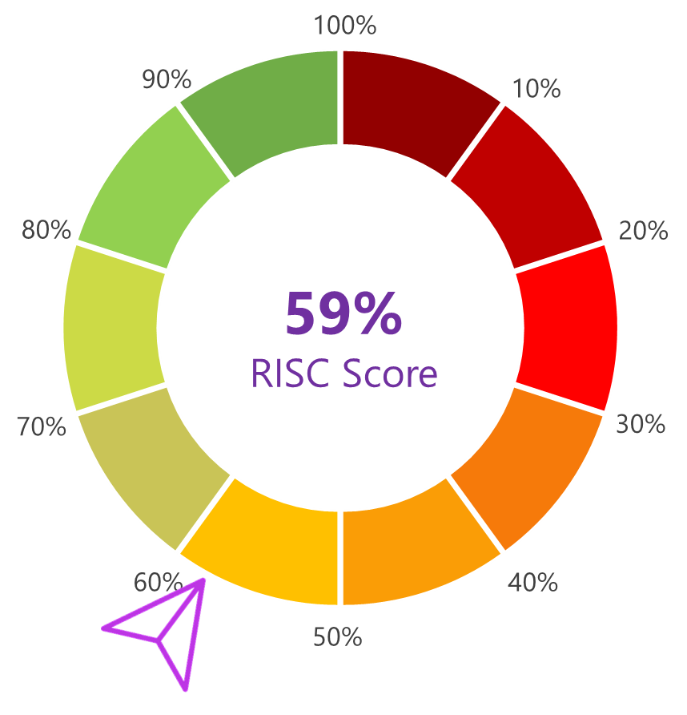
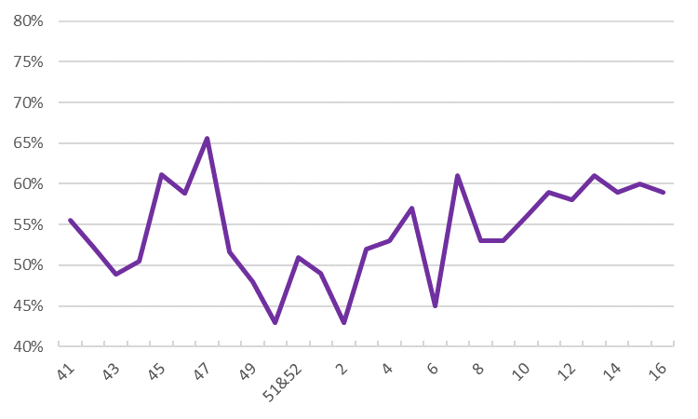
Week 16 | April 16 - 22, 2024
Page 1/8
SPACE CYBERSECURITY WEEKLY WATCH
Week 16
April 16 – 22, 2024
GEOPOLITIC
Timeframe : Weekly
# of articles identified : 48
Est. time to read : 1h30
Articles, company’s communications, whitepapers, academic works, podcast, and sources not to be missed on the topic of space cybersecurity over a specified timeframe.
MARKET INTELLIGENCE
TRAINING & EDUCATION
THREAT INTELLIGENCE
TECHNOLOGY
REGULATION
Overview & RISC Score
IMPORTANT NEWS
0
10
GEO
MAR
TRA
CTI
TEC
REG
RISC Score Evolution
This W16 shows a little decrease from last week’s RISC score (1%). It still manages to be on a higher level than last year same period, following the increasing tendency since W7.
Decrease from last week
(-1%)
This week's RISC score is 59%. This week, a CyberInflight team member just came back from the ESA Academy Cybersecurity Training Course. During this session, we explored cybersecurity threats and risks, specifically tailored to the space sector, and an immersion in security engineering for space systems. In addition, the US Space Force announced its collaboration with two companies, Rocket Lab and True Anomaly, on a first-of-its-kind mission, specially designed to demonstrate how the military counter “orbital aggression”. On the market front, ISAC and SIA-India partner to revolutionize Space Cybersecurity, to set new standards, and safeguard our space and defense sectors. In addition, Sylvester Kaczmarek, Chief Technology Officer à OrbiSky, discusses the challenges and innovations shaping the future of cybersecurity in space, to safeguard essential global technologies. On the regulatory front, the European Commission is delaying two key space initiatives, a space law and a contract for a satellite constellation, until a least this summer, likely until parliamentary elections in June. On the Technology front, USC ISI researchers are building tools to solve safety problems in space operations, and creating test beds to simulate cyberattacks in space. Finally, Russian hackers have replaced Ukrainian channels with Russian propaganda. Indeed, as a result of a cyberattack in
Latvia on the satellite signal of the channel where the Ukrainian station FREEDOM was
supposed to be broadcast, Russian propaganda content was displayed on April 17th.

Slide 2
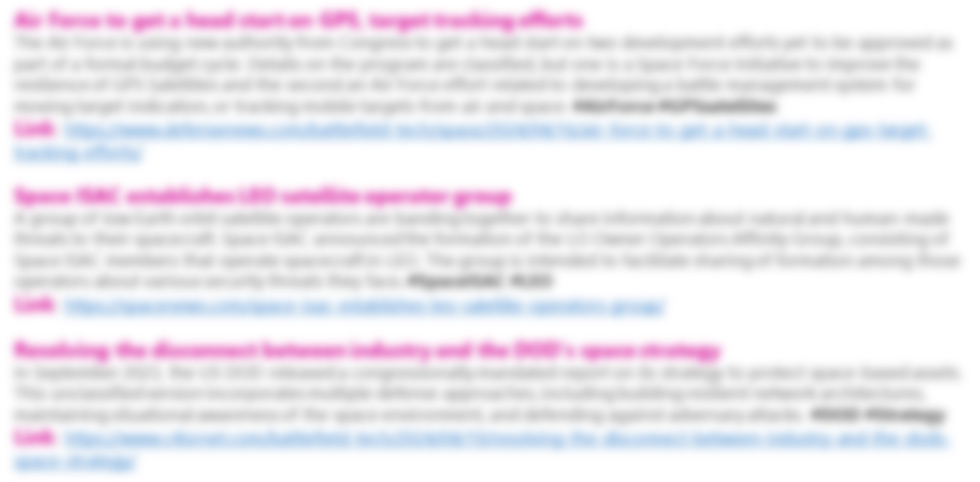
Week 16 | April 16 - 22, 2024
Page 2/8
🎉 CYBERINFLIGHT’S NEWS 🎉
CyberInflight attending ESA Academy’s cybersecurity training course
From April 8th to 12th ESA Academy selected 30 highly motivated Bachelor and Master students to attend the Cybersecurity Training Course 2024. In this training session, students explored an introduction about cybersecurity threats and risks, specifically tailored to the space sector, followed by an immersion in security engineering for space systems prioritizing cyber protection alongside operational risk management for cybersecurity. #ESAacademy #Cybersecurity
Link: https://www.linkedin.com/company/30108787/admin/feed/posts/
GEOPOLITIC
US Space Force plans to conduct first military exercises in orbit
The US Space Force announced it is collaborating with two companies, Rocket Lab and True Anomaly, on a first-of-its-kind mission designed to demonstrate how the military counter “orbital aggression”. During this mission, the spacecraft, built and launched by Rocket Lab, will chase another satellite built by True Anomaly, a Colorado startup. #USSF #Spacemission
Link: https://prog.world/us-space-force-plans-to-conduct-first-military-exercises-in-orbit/

Slide 3
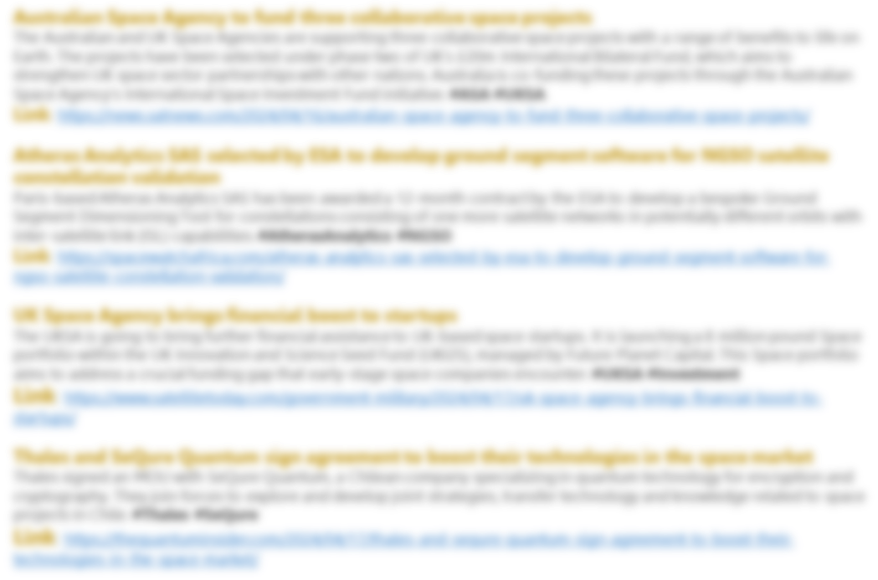
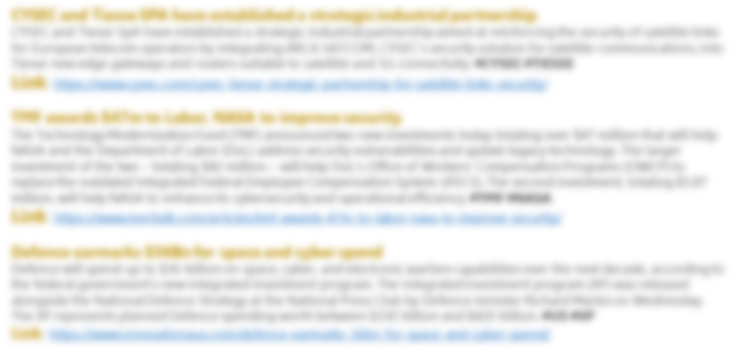
MARKET & COMPETITION
Week 16 | April 16 - 22, 2024
Page 3/8
ISAC and SIA-India partner to revolutionize Space Cybersecurity
ISAC is proud to announce its collaboration with SIA-India, which is committed to revolutionizing space cybersecurity. This collaboration, solidified by the recent MoU signing, is setting new standards that will safeguard our space and defense sectors. #ISAC #SIAIndia
Link: https://www.linkedin.com/posts/isacindia_spacecybersecurity-spacesecurity-innovation-activity-7186359537010970624-FdWs/

Slide 4
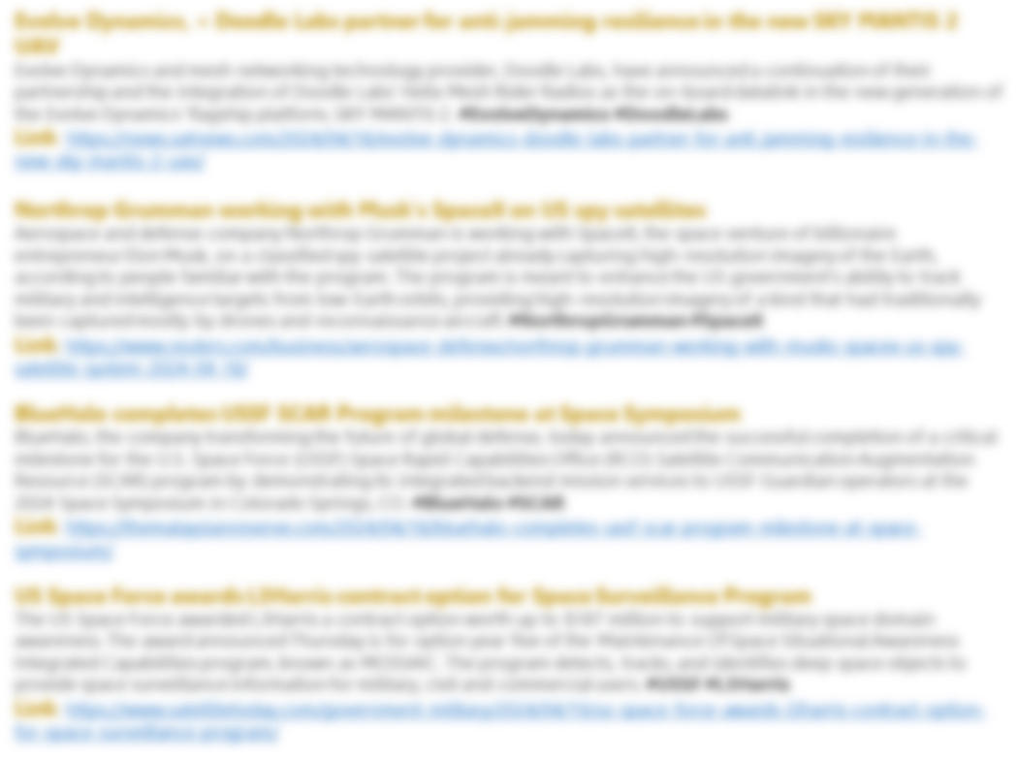
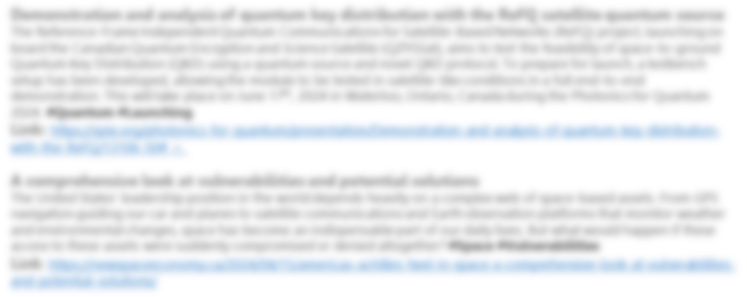
MARKET & COMPETITION
Week 16 | April 16 - 22, 2024
Page 4/8
TRAINING & EDUCATION

Slide 5
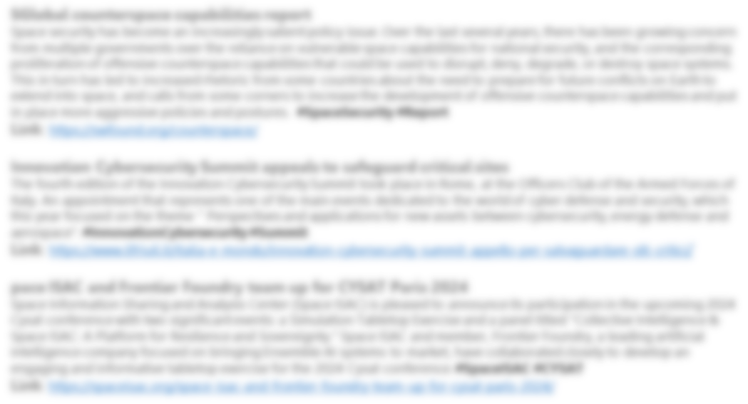
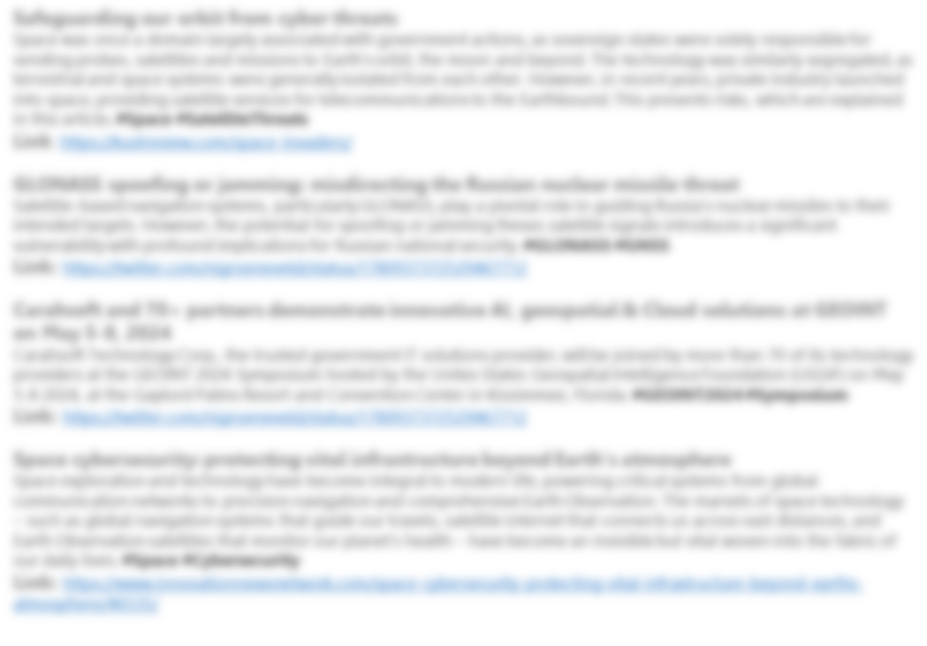
Week 16 | April 16 - 22, 2024
Page 5/8
TRAINING & EDUCATION
Cybersecurity challenges in space exploration
Sylvester Kaczmarek describes in his Amplify article a variety of threat scenarios along with a sobering collection of real-word cybersecurity incidents in space missions. He advises a number of strategies for mitigating space-related cyber threats, including AI models that anticipate and prevent attacks before they occur, encryption methods resistant to quantum attacks, and international cooperation to harmonize regulations across countries. #Space #Cybersecurity
Link: https://www.cutter.com/article/cybersecurity-challenges-space-exploration

Slide 6
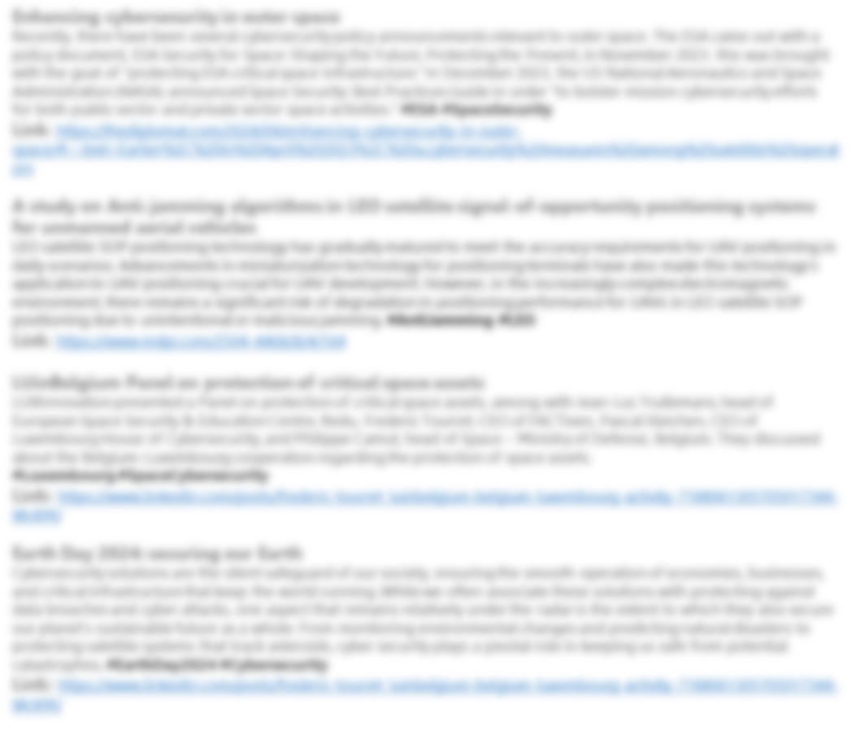
Week 16 | April 16 - 22, 2024
Page 6/8
TRAINING & EDUCATION
REGULATORY
EU to delay space law, constellation contract
The European Commission is delaying two key space initiatives, a space law and a contract for a satellite constellation, until a least this summer. Thierry Breton, EU commissioner for the internal market, said at a meeting of an EU parliamentary committee, that the release of a legislative proposal for an EU space law, expected earlier this year, would be delayed likely until parliamentary elections in June. #Spacelaw #EU
Link: https://spacenews.com/eu-to-delay-space-law-constellation-contract/
6

Slide 7
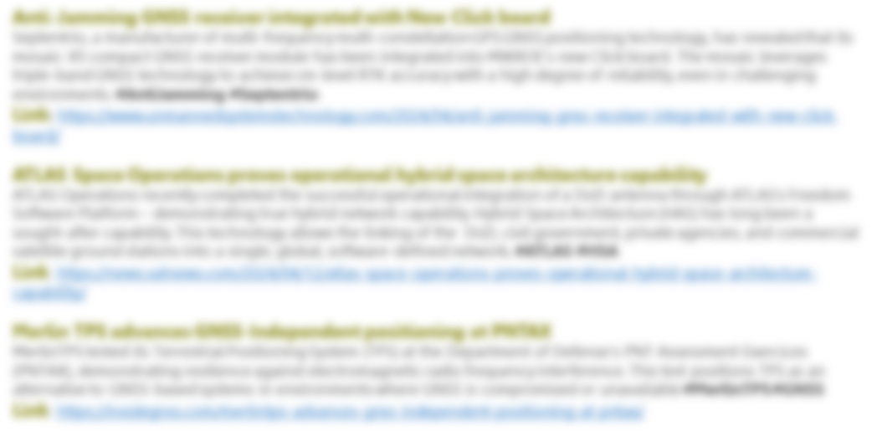
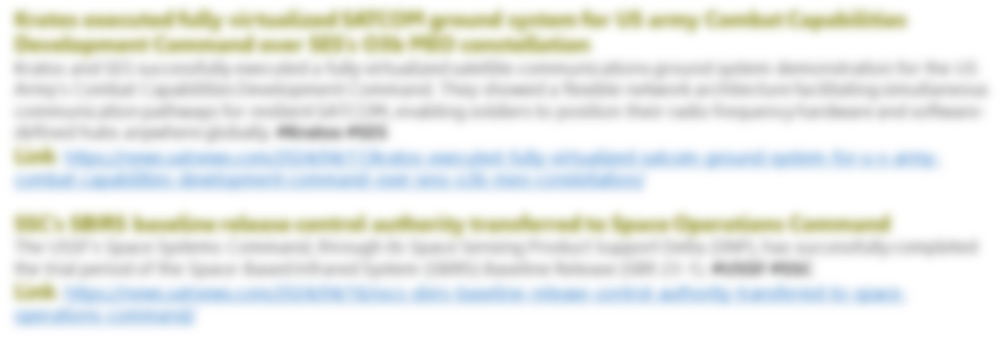
TECHNOLOGY
Week 16 | April 16 - 22, 2024
Page 7/8
Solving the space dilemma
USC ISI researchers are building tools to solve safety problems in space operations, and creating test beds to simulate cyberattacks in space. Space systems being often exposed to operational threats, sometimes directed toward hardware like space debris’ harmful effects to spacecraft. They can also affect software, such as breaches in satellite communication security. USC Viterbi’s Information Science Institute (ISI) and Space Engineering Research Center (SERC) researchers are devising solutions to these space dilemmas. #Space #Security
Link: https://viterbischool.usc.edu/news/2024/04/solving-the-space-dilemma/
7

Slide 8
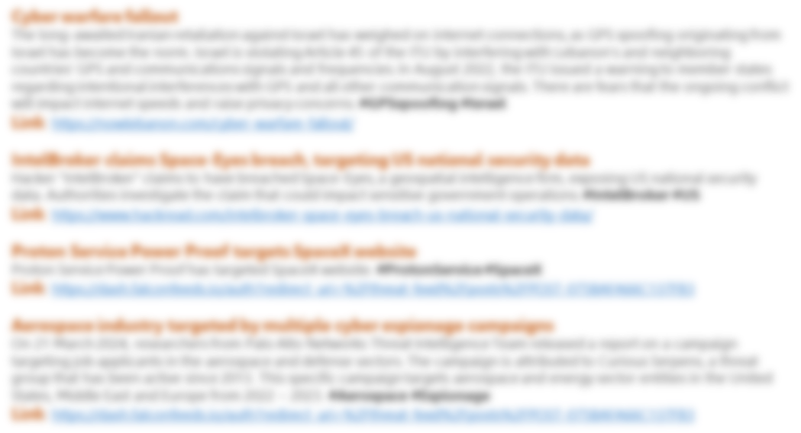
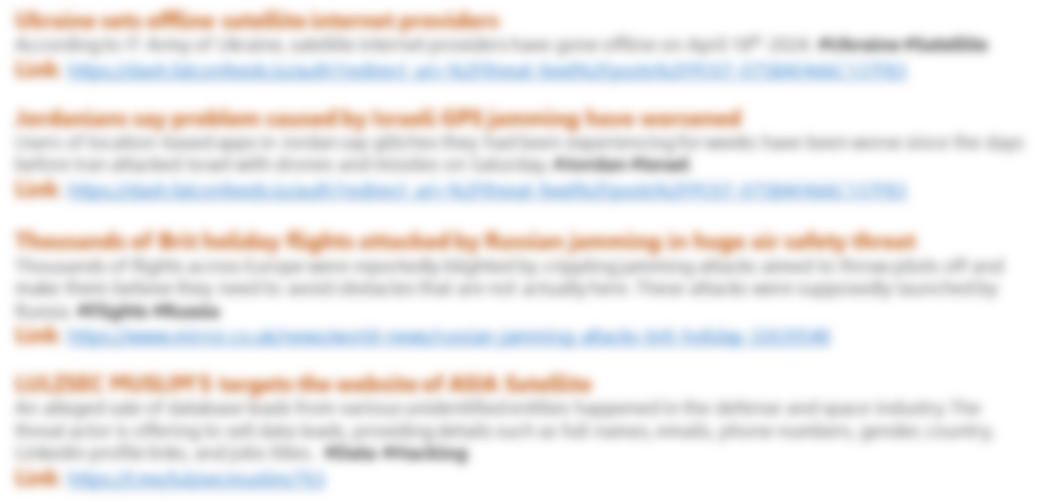
THREAT INTELLIGENCE
Week 16 | April 16 - 22, 2024
Page 8/8
Latvia: hackers replace Ukrainian channel with Russian propaganda
As a result of a cyberattack in Latvia on the satellite signal of the channel where the Ukrainian station FREEDOM was supposed to be broadcasted, Russian propaganda content was displayed on April 17th. #Hackers #SatelliteSignal
Link: https://dash.falconfeeds.io/auth?redirect_uri=%2Fthreat-feed%2Fposts%2FPOST-075BAFA66C137FB3
CyberInflight is a Market Intelligence company dedicated to the topic of Space Cybersecurity. The company provides strategic market and research reports, bespoke consulting, market watch & OSINT researches and cybersecurity awareness training.
Contact us at: research@cyberinflight.com
8

